Slide 1
Computer users
Volodia Kuzmenko
Group IO-21
Notes:
We designed this template so that each member of the project team has a set of slides with its own theme. Members, here’s how you add a new slide to just your set:
Mark where you want to add the slide: Select an existing one in the Thumbnails pane, click the New Slide button, then choose a layout. The new slide gets the same theme as the other slides in your set.
Careful! Don’t annoy your fellow presenters by accidentally changing their themes. That can happen if you choose a different theme from the Design tab, which changes all of the slides in the presentation to that look.

Slide 2
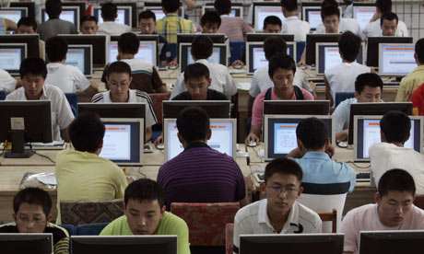
Different fields, where we are use computers
Business
Finance
Entertainment
Scientific Research
Education

Slide 3

Computers in business
Computers Facilitate Communication
Data Mining Benefits
Customer Relationship Management
Order Fulfillment
Design and Graphics
Marketing and Advertising
Using Computers to Manage People
Computer Administration

Slide 4

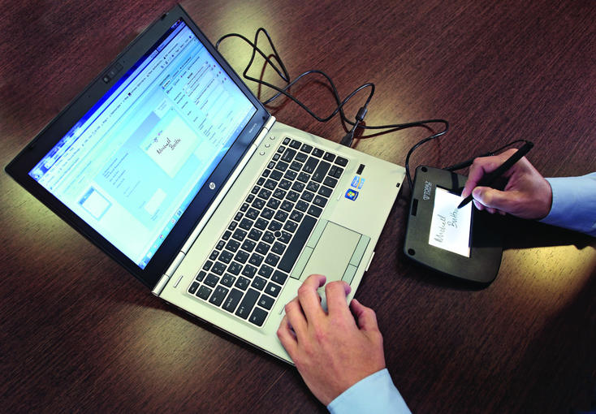
Computers Facilitate Communication

Slide 5

Data Mining Benefits

Slide 6

Customer Relationship Management

Slide 7


Marketing and Advertising

Slide 8


Design and Graphics

Slide 9

Advertise and market service.

Slide 10
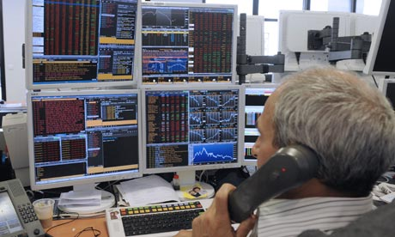
Computer in Finance
Communication
Spreadsheet Software
Data Storage
Programmed Transactions
Financial Information

Slide 11


Communication

Slide 12
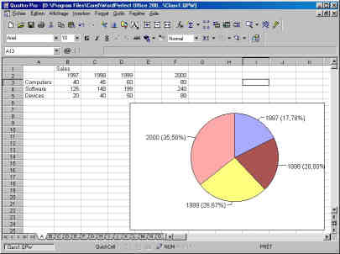
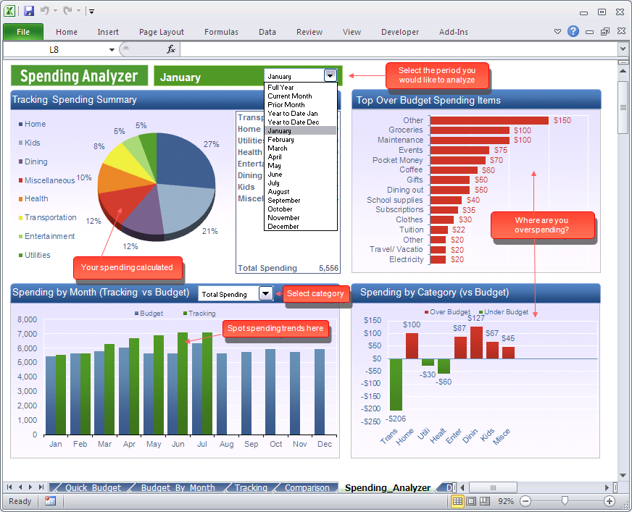
Spreadsheet Software

Slide 13


Data Storage

Slide 14
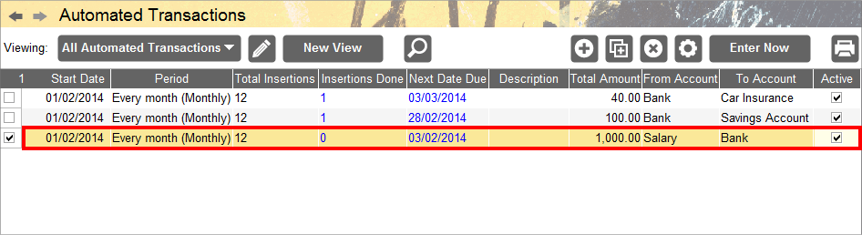
Programmed Transactions

Slide 15


Financial Information

Slide 16
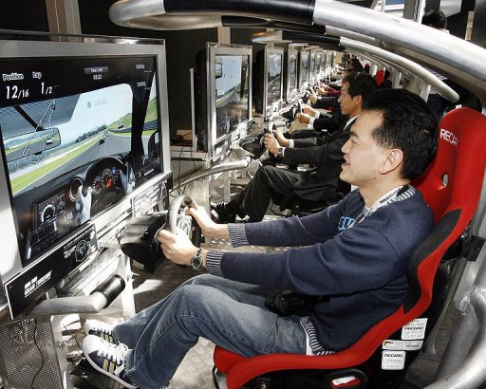
Computers in Entertainment
Music
Television and Movies
Art
Games

Slide 17
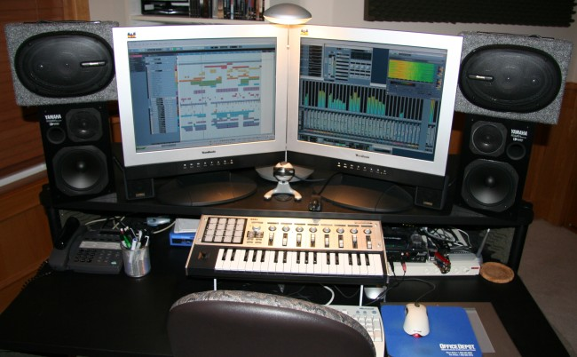
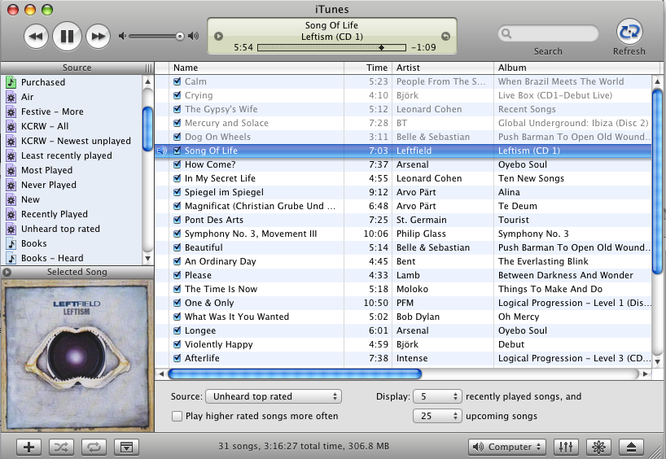
Music

Slide 18
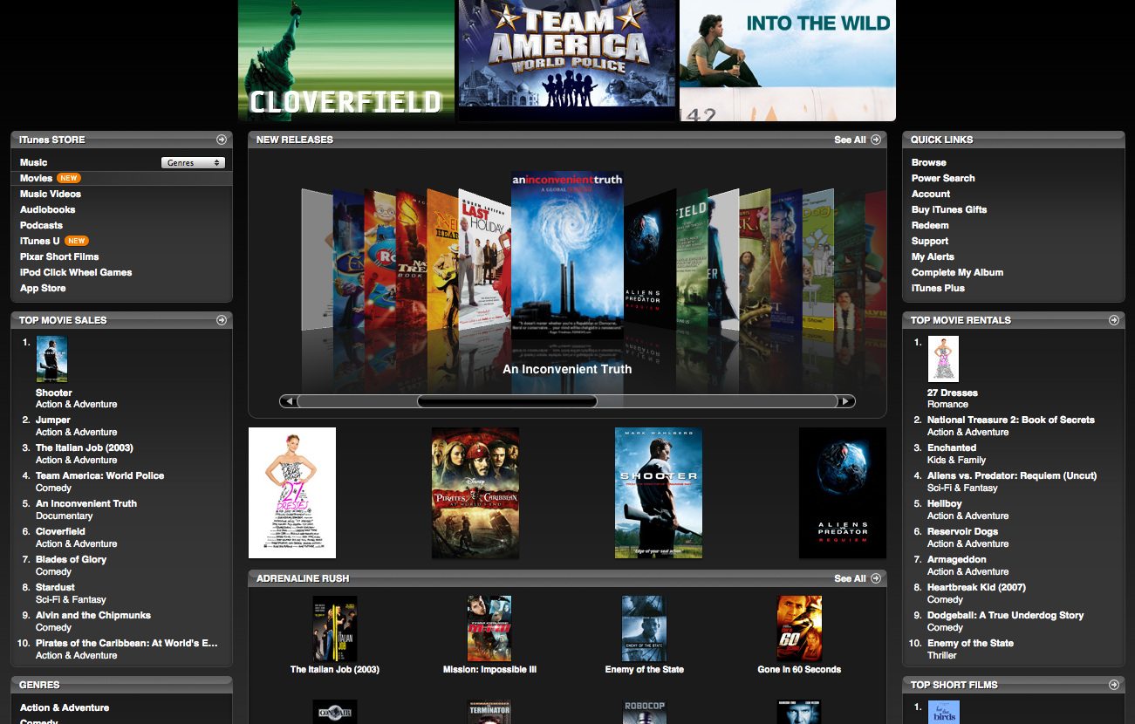
Television and Movies

Slide 19

Art

Slide 20
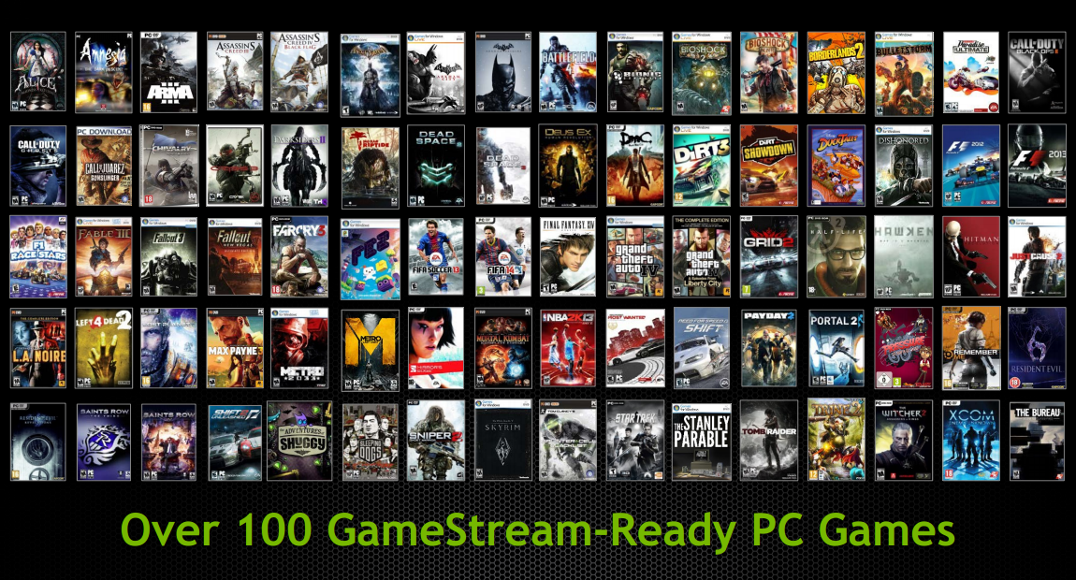
Games

Slide 21

Computers in Scientific Research
Complex Data Analysis
Solving Mathematical Equations
Prediction Modeling

Slide 22
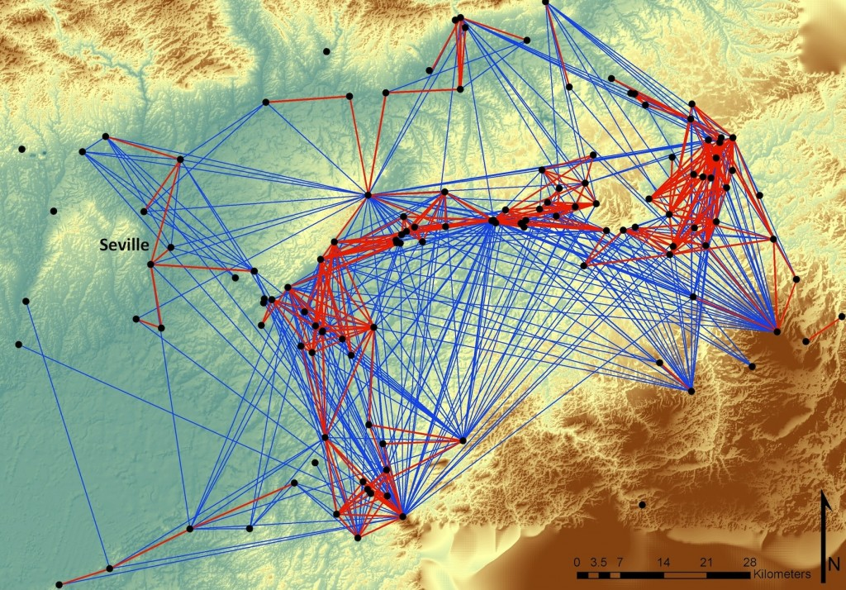
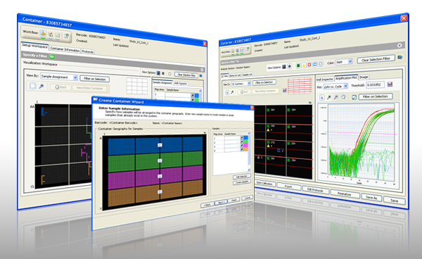
Complex Data Analysis

Slide 23
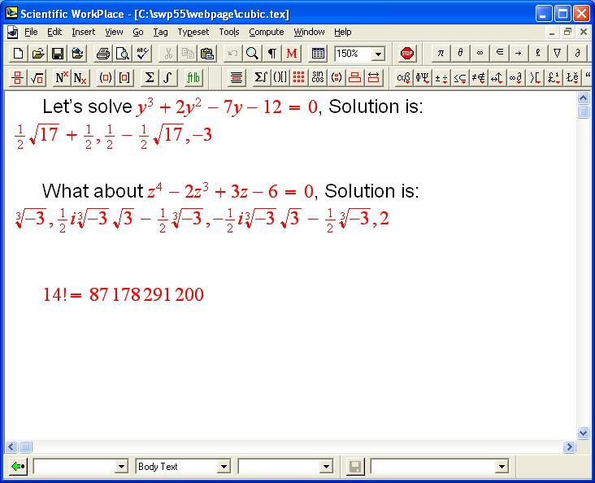
Solving Mathematical Equations

Slide 24
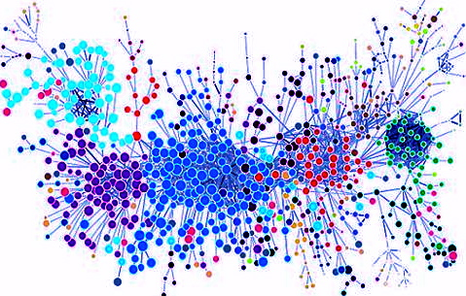
Prediction Modeling

Slide 25

Computers in education
Audio-visual aids in teaching
Better presentation of information
Access to the Internet
Quick communication between students, teachers and parents

Slide 26


Online education

Slide 27


Presentation of information

Slide 28

Access to the Internet

